Slide 1
Prediction of NBA Player Points per Game
Machine Learning
Seyi Oyesiku

Slide 2
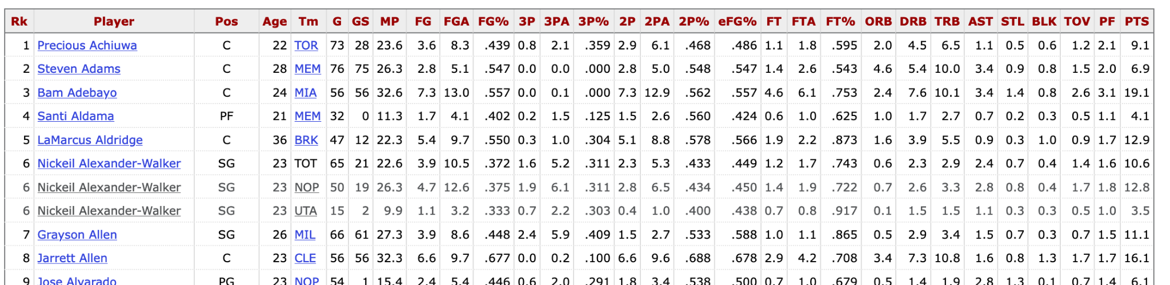
Dataset
The datasets used for this study were from Basketball Reference, a trusted NBA statistics website that provides detailed statistics on players every season.
Data from the 2018-2019, 2019-2020, 2020-2021, and 2021-2022 NBA seasons were utilized. Below is a snapshot of one of the datasets used.

Slide 3
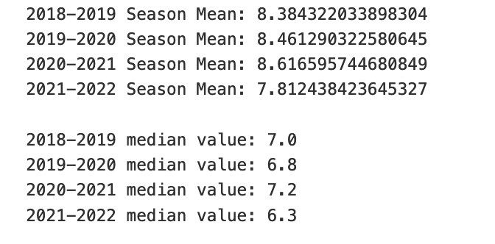
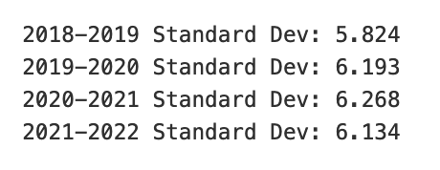
Exploratory Data Analysis
In order to begin our EDA, we will look at some descriptive statistics of our datasets we have acquired. The Mean, median, and standard deviation values are shown below for each NBA season

Slide 4
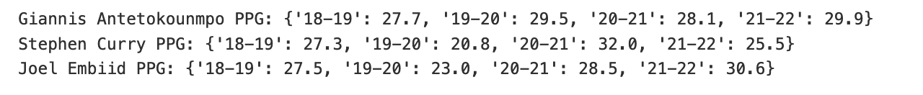
Exploratory Data Analysis
To further explore the data set, we looked at the points per game of 3 of the best 20 players in the NBA for the 2021-2022 season
Additionally, plots were created to understand their scoring patterns over the last few years.
Player rankings were sourced from the NBC, where an article detailing the top 20 players for the season is displayed.

Slide 5
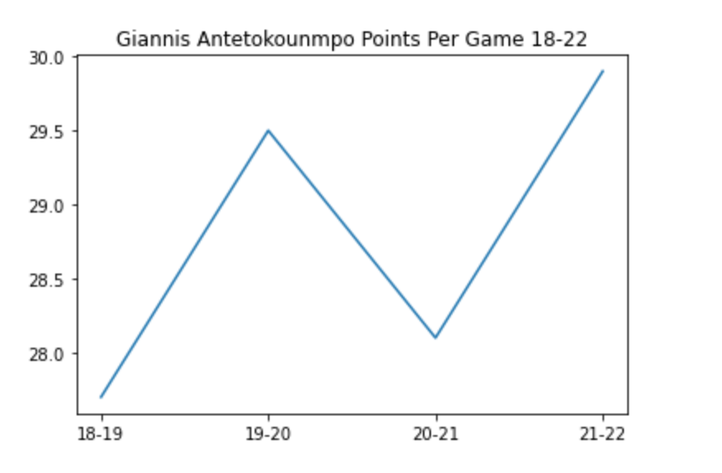
Exploratory Data Analysis
The plots below show the pattern in the points per game of the three players that we chose for this analysis: Giannis Antetokounmpo, Stephen Curry, and Joel Embiid.

Slide 6
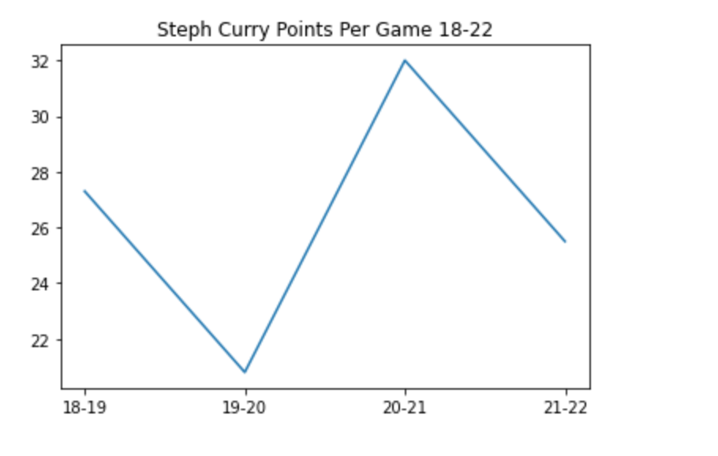
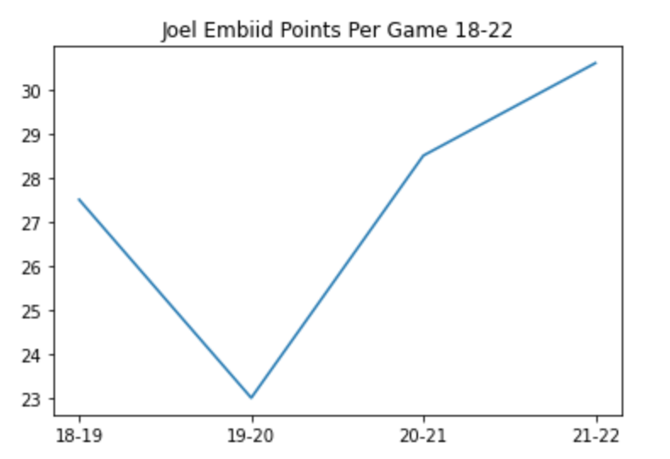
Steph Curry and Joel Embiid PPG Plots

Slide 7
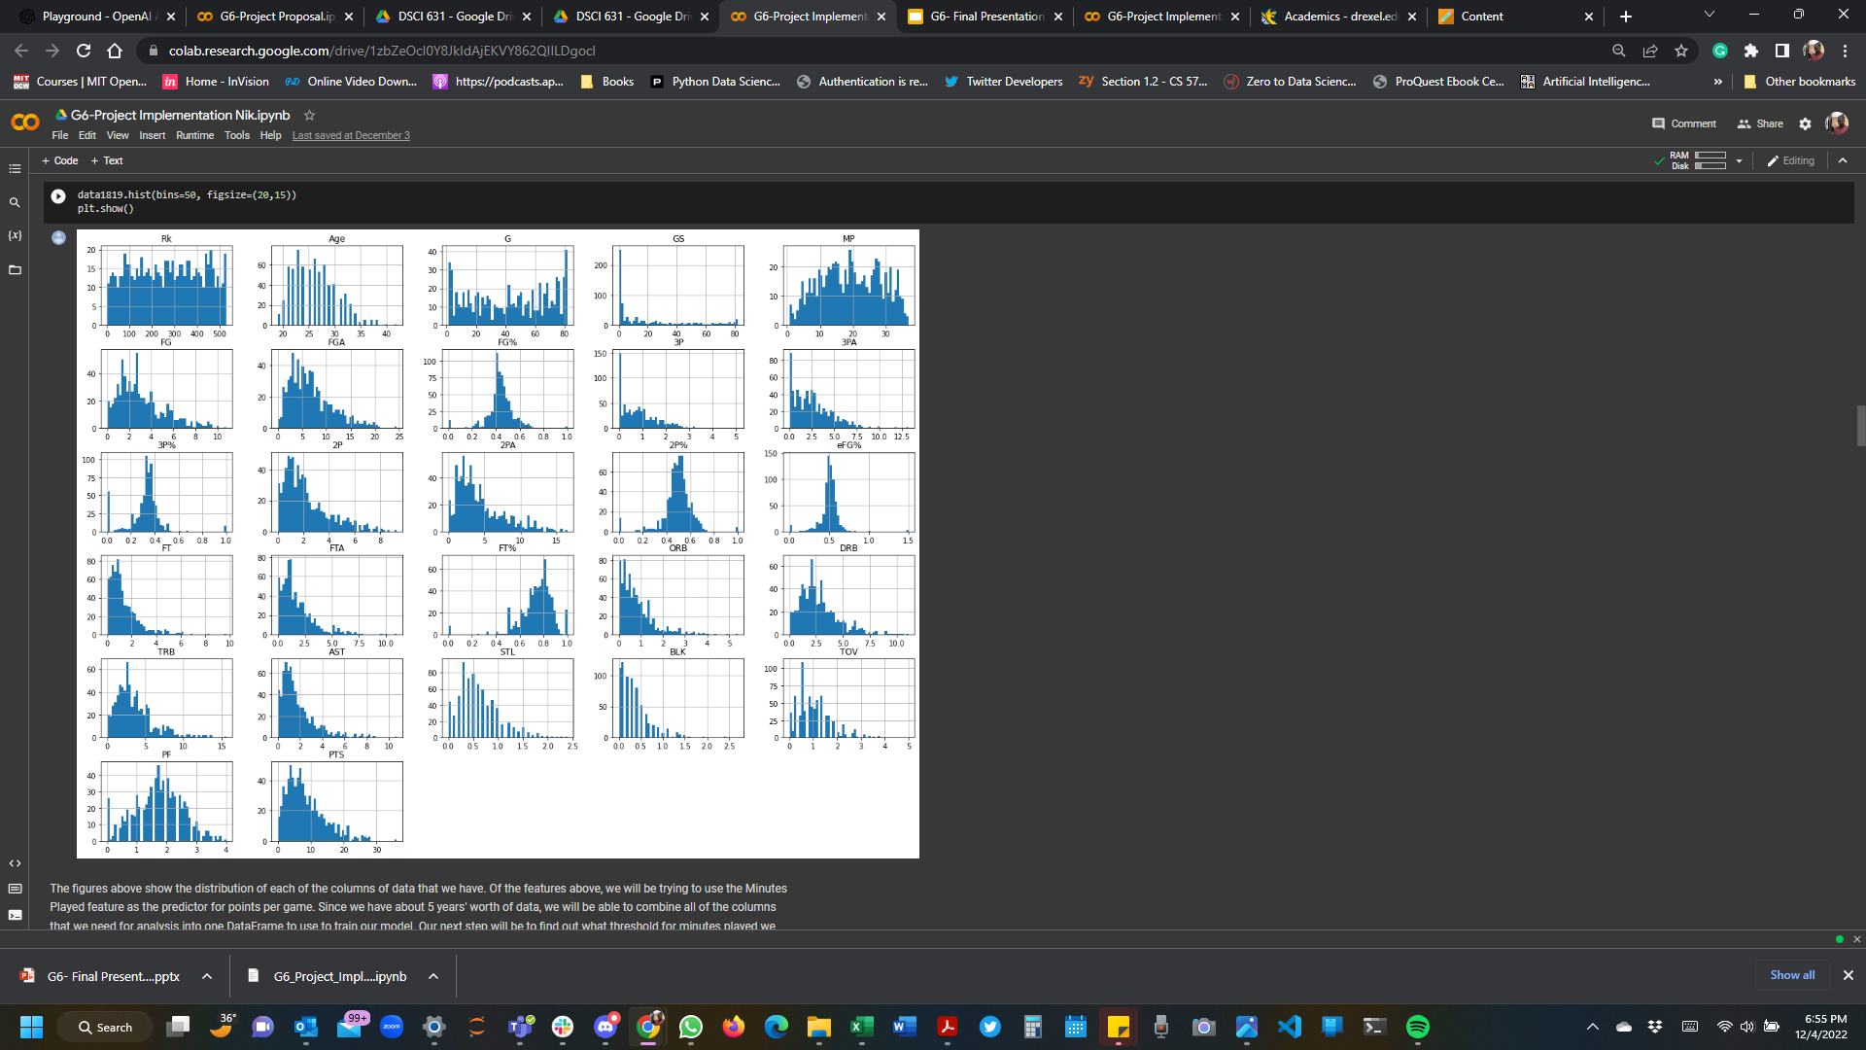
NBA Season Stats Histograms 2018-2019

Slide 8
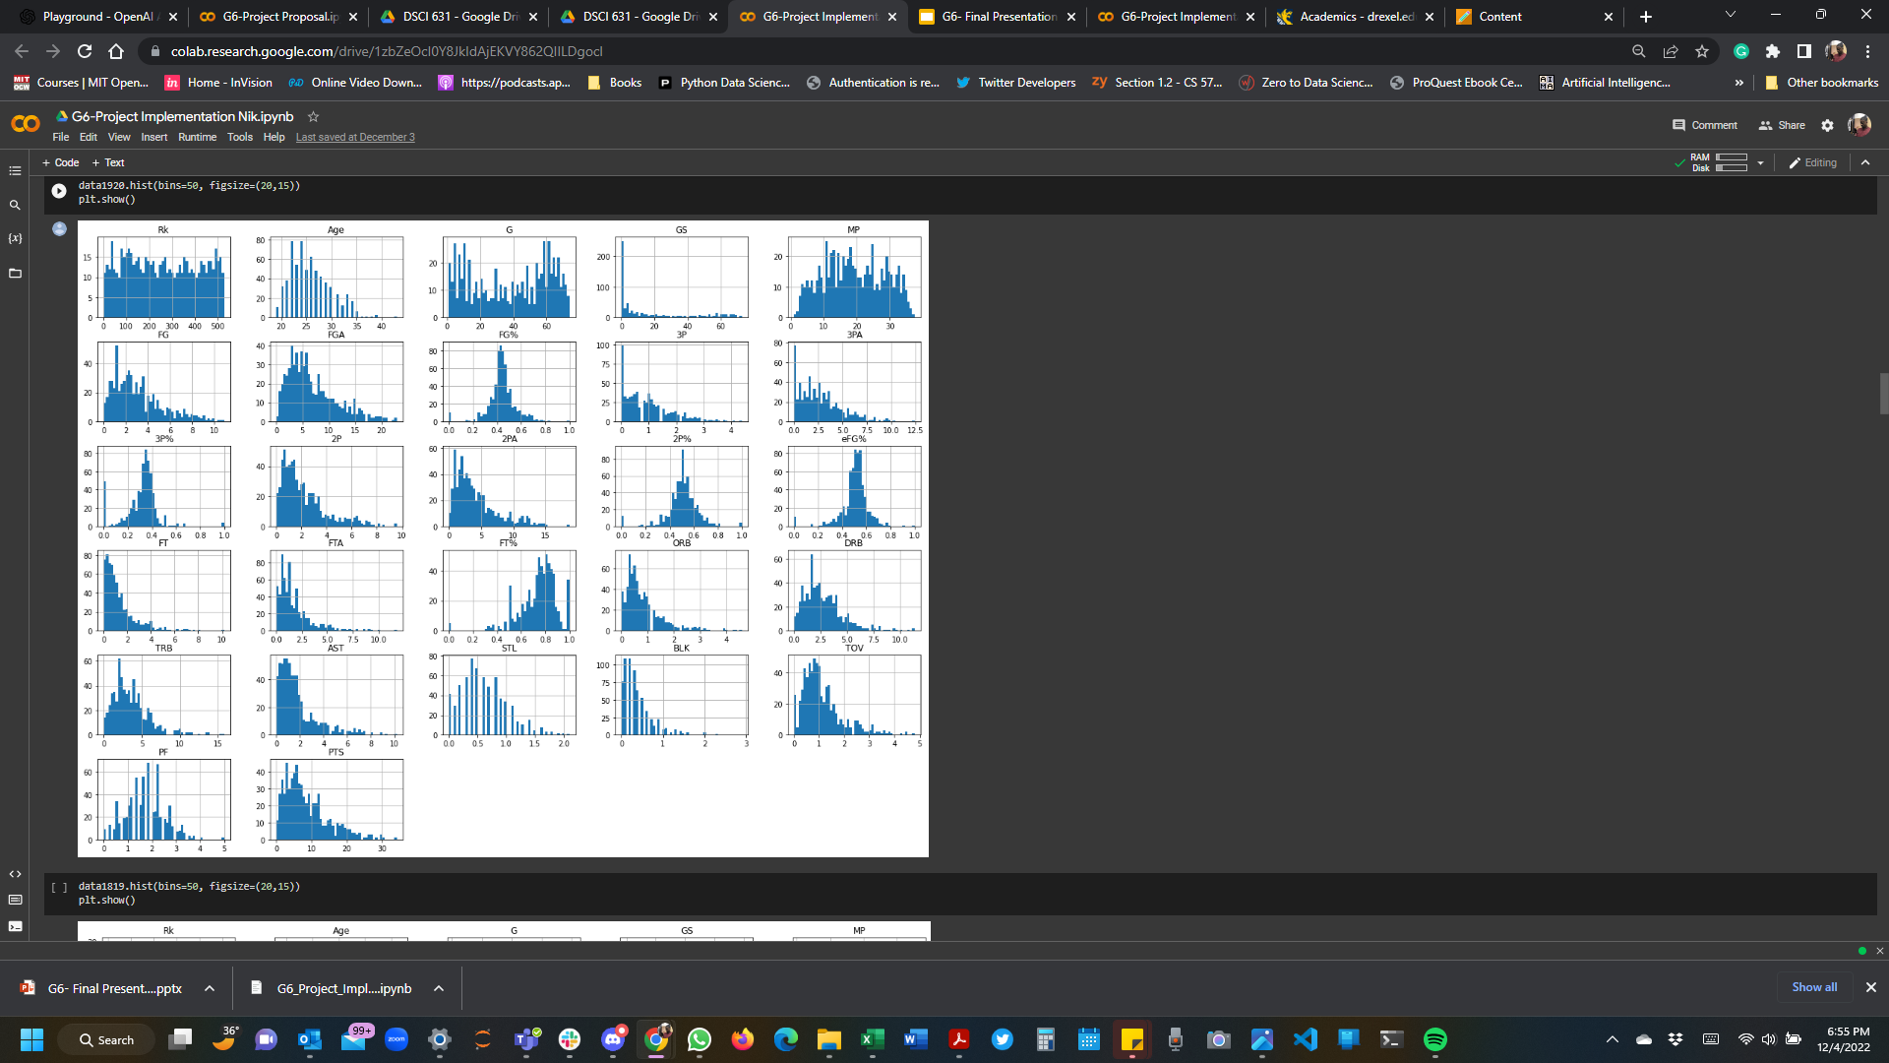
NBA Season Stats Histograms 2019-2020

Slide 9
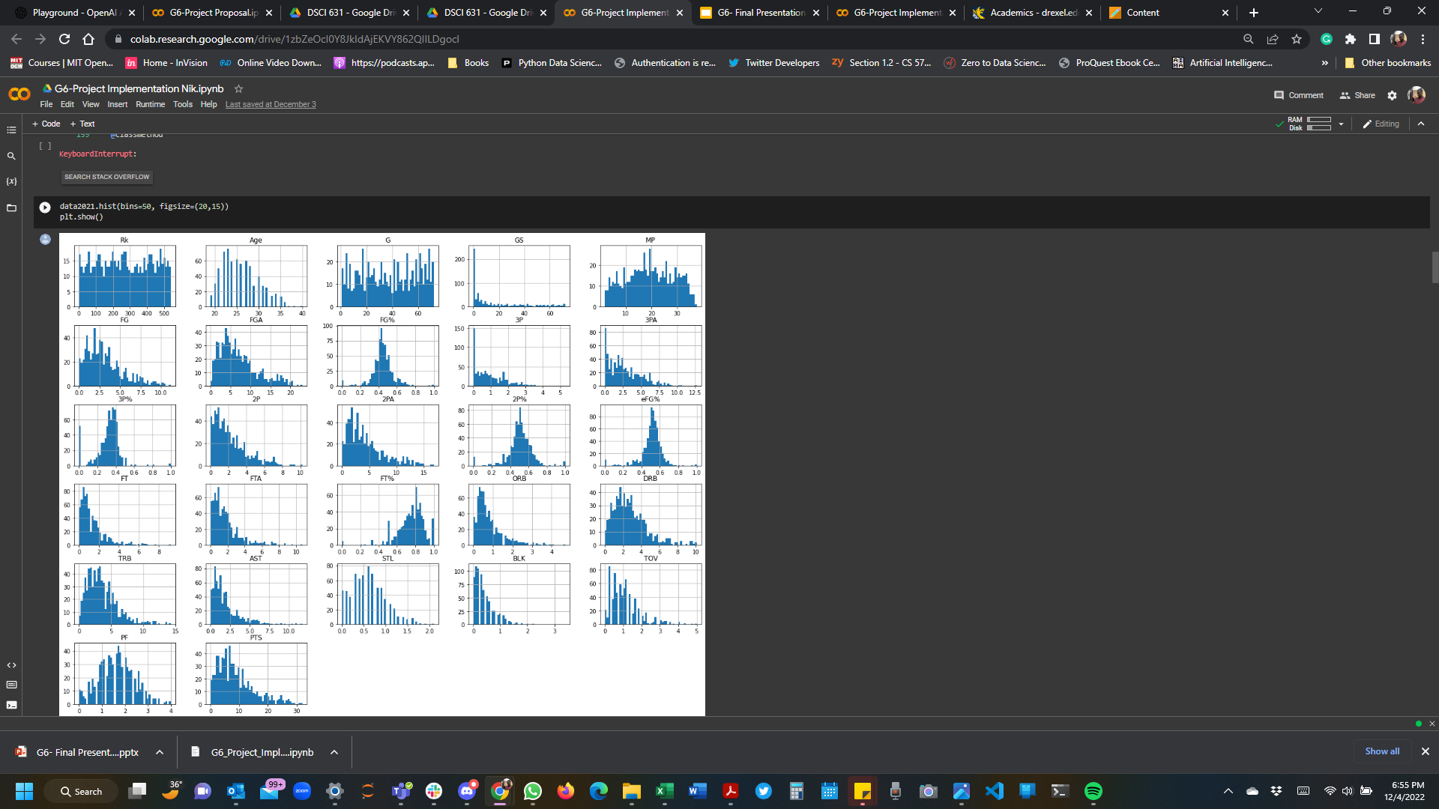
NBA Season Stats Histograms 2020-2021

Slide 10
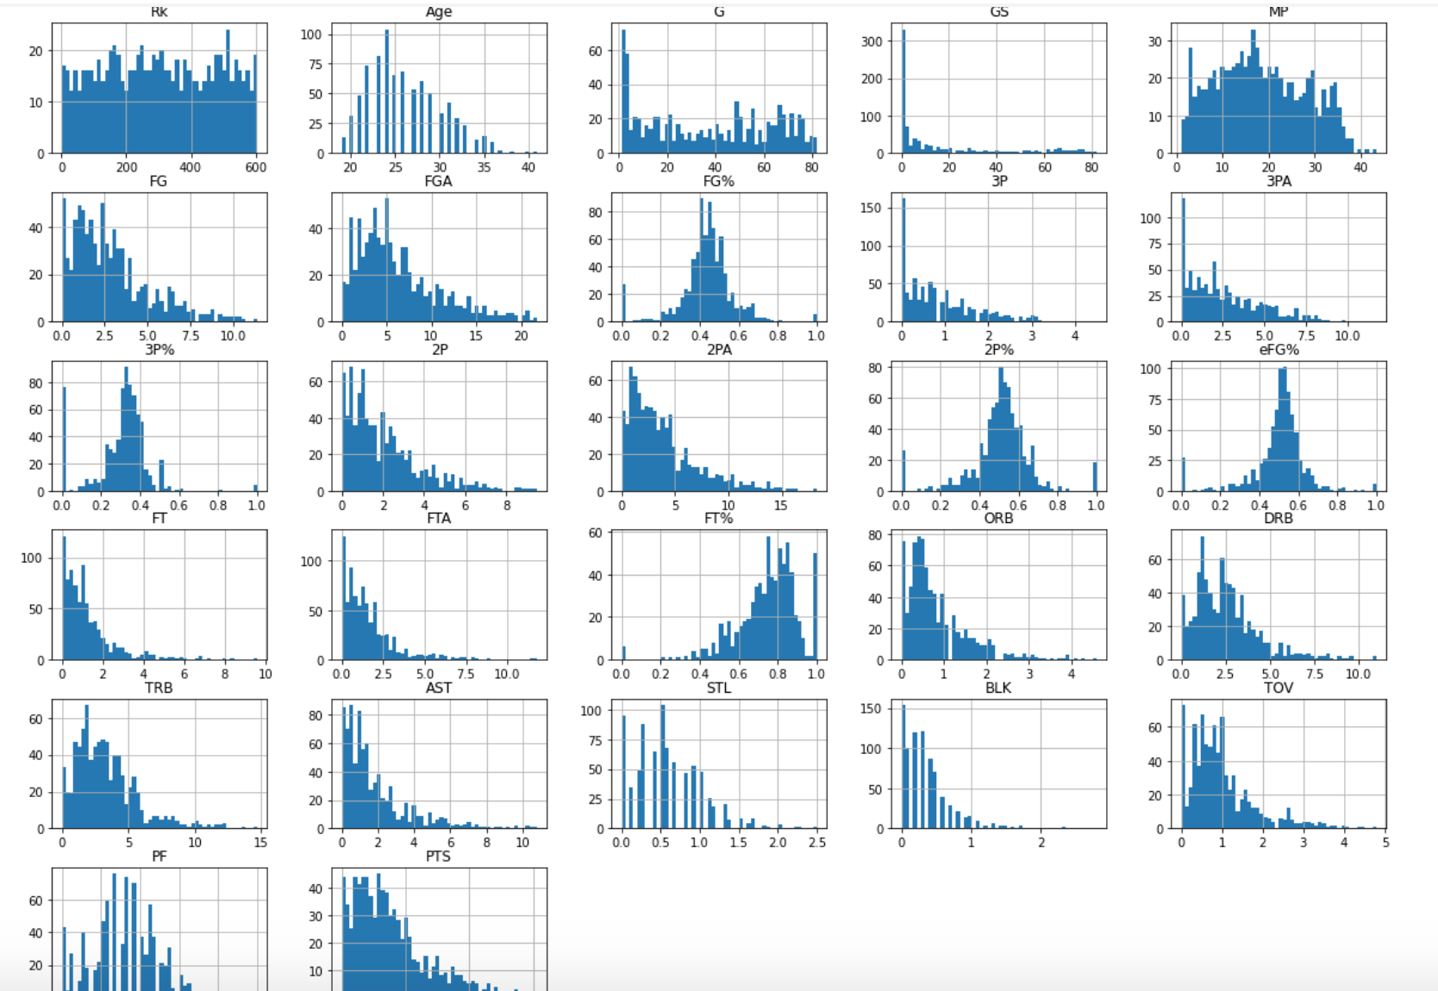
NBA Season Stats Histograms 2021-2022

Slide 11
Feature Selection
The figures above show the distribution of each of the columns of data that we have. Some of the features we would like to explore are:
Minutes Played
Field Goals Attempted/Made
Free Throws Attempted/Made
Field Goal Percentage
Free Throw Percentage
These features were selected because they are directly correlated to an NBA player’s points per game, and we will be using the Minutes Played feature to further filter out dataset.
Since we have about 5 years' worth of data, we will be able to combine all of the columns that we need for analysis into one DataFrame to use to train our model. Our next step will be to find out what threshold for minutes played we should set in our dataset.

Slide 12
Threshold Decision
Role players in the NBA are players who play only in specific situations. Because of this, they have very limited minutes, and predicting their points per game may not be as necessary
We want to focus on players who have a significant impact on the game, and the decision was made to filter our combined dataset to only players who play more than one half of basketball games
This is because these players are usually starters or players who come off the bench, but they are still players who play a significant portion of the game, and we can analyze their minutes played along with the other features we selected in order to predict their scoring capabilities in a game

Slide 13
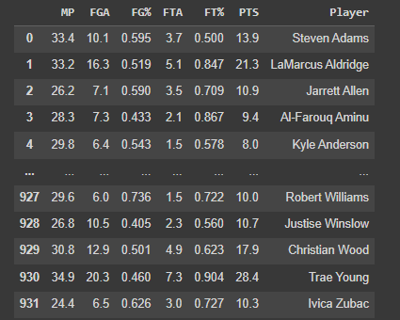
New Filtered Data
We filtered all of our data to just the players who played above 24 minutes.
We need to now look at each of our features to determine what their effect on our players' points per game would be.

Slide 14
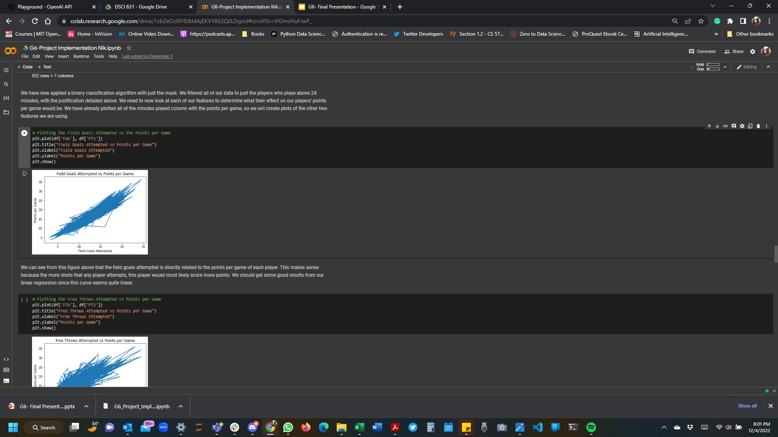
Field Goals Vs PPG
We can see from this figure above that the field goals attempted is directly related to the points per game of each player. This makes sense because the more shots that any player attempts, this player would most likely score more points. We should get some good results from our linear regression since this curve seems quite linear.

Slide 15
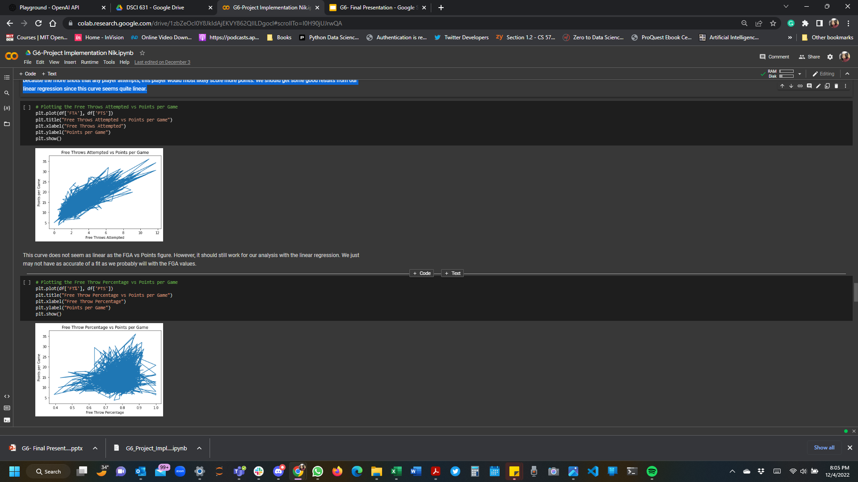
Attempted free throws vs PPG
This curve does not seem as linear as the FGA vs Points figure. However, it should still work for our analysis with the linear regression. We just may not have as accurate of a fit as we probably will with the FGA values.

Slide 16
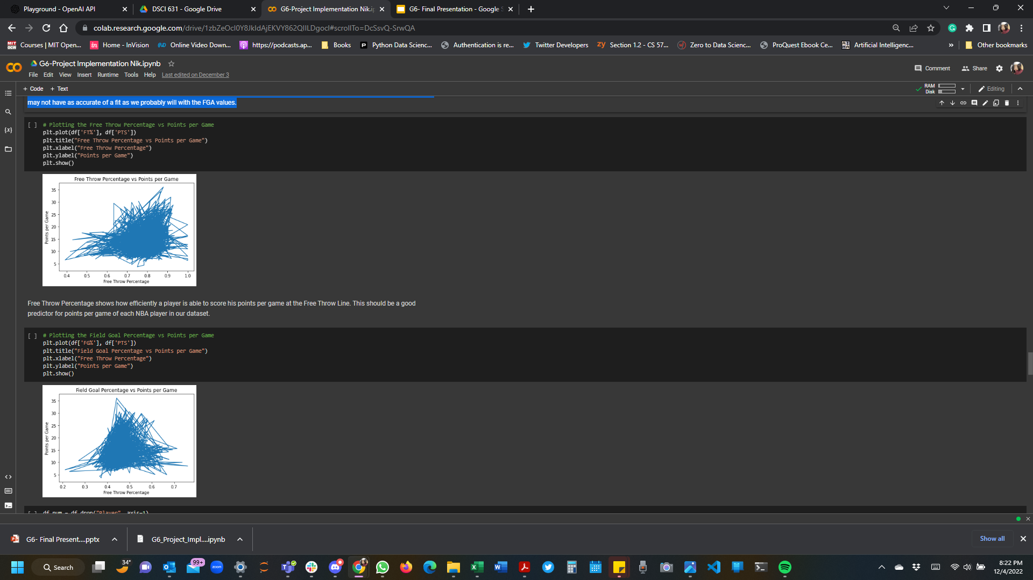
Free Throw percentage Vs PPG
Free Throw Percentage shows how efficiently a player is able to score his points per game at the Free Throw Line. This should be a good predictor for points per game of each NBA player in our dataset.

Slide 17
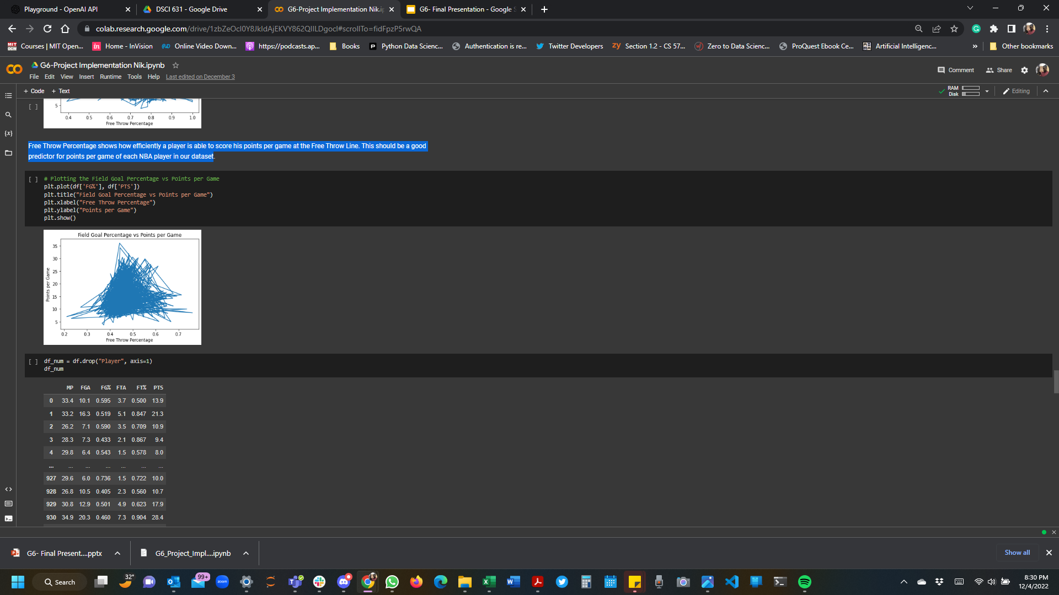
Field Goal Percentage Vs PPG
The field goal percentage shows efficiently a player is able to score his points off every shot in the game other than a free throw. This should be useful for our analysis, even though the relationship is not entirely linear.

Slide 18
Model Selection
Since we have a target variable, we will be applying 3 supervised learning models.
Linear Regression
Because we saw that most of the features we are analyzing have a linear relationship with the points per game, this would be a good model to start with
K-Nearest Neighbors
No information loss, and can train quickly. KNN also works well for less than 20 features
Random Forest
To enable us achieve more accurate results in our prediction

Slide 19
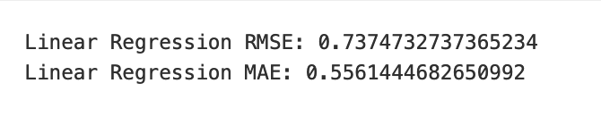
Linear Regression
It seems that our linear regression model was actually quite accurate when predicting the points per game values. We see that the RMSE value is 0.737, which is close to 0.
Since we know that the lower the RMSE value, the better the model was able to predict our points per game, we know that this model worked well.
This is the same case with the mean absolute error.

Slide 20
K Nearest Neighbors
The first step in this algorithm was finding the ideal number of neighbors that would yield us the best results.
After iterating through 3-7 neighbors, we saw the following R-squared values:
0.9219 for 3 neighbors
0.9252 for 4 neighbors
0.9251 for 5 neighbors
0.9241 for 6 neighbors
0.9230 for 7 neighbors
Because 4 neighbors had the highest R^2 value, we decided to use that for our model

Slide 21
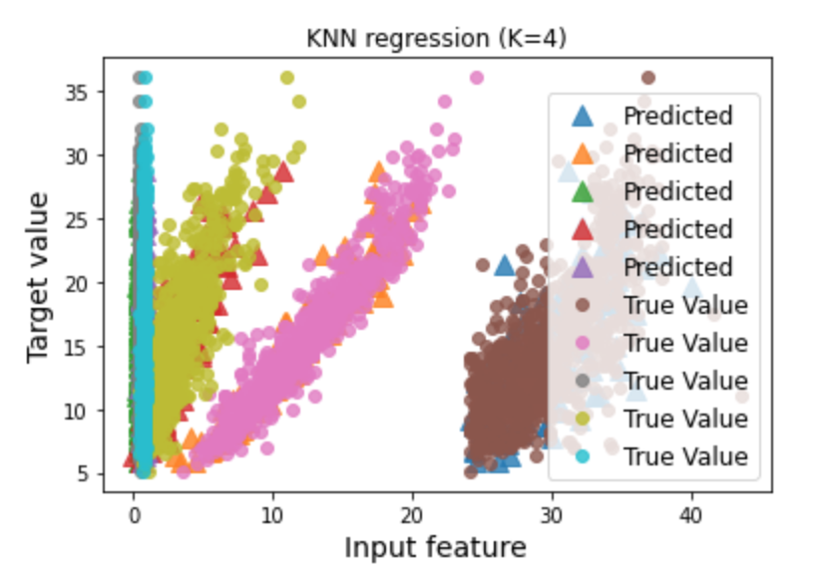
K Nearest Neighbors
Based on the plot , it seems that because of the high R^2 value, in addition to seeing how close the predicted points are to each true value, we know that this K-Nearest Neighbors model worked well for us.

Slide 22
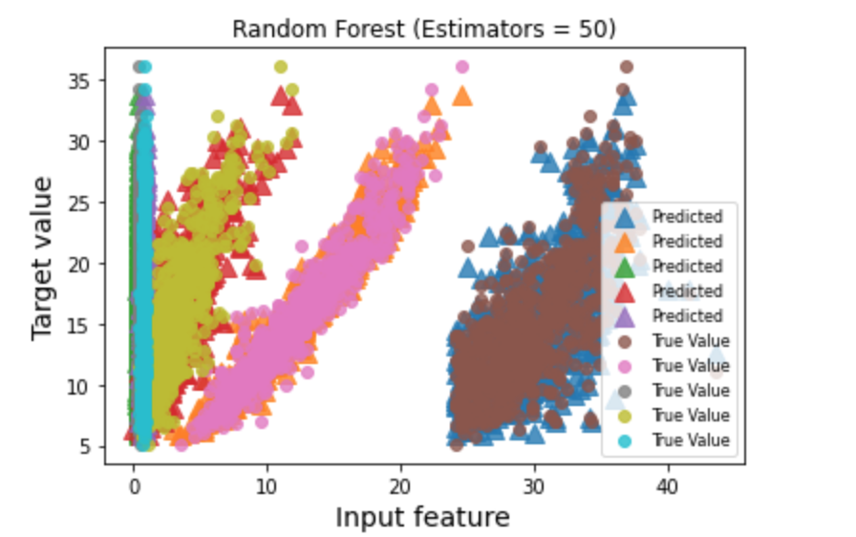
Random Forest
For the random forest, we used 50 estimators
The R^2 value for this model was 0.9617, which makes it our best model of the three that we have implemented.

Slide 23
Comparison of Models
Linear Regression had an RMSE error of 0.737, which makes this model a good predictor for points per game, but it was not the best model that we had
K Nearest Neighbors performed better, because the R^2 value was very close to 1, at 0.925.
The Random Forest model was the best predictor for points per game. This is because it had an R^2 value of 0.962, which is higher than the KNN predictor model.

Slide 24
Limitations and Future Work
This project only considered the per game data from the last 4 NBA seasons, so it was limited in the information that we were able to gather in this time frame.
There are also other factors such as team chemistry and coaching that can affect players’ performance in games.
Players being traded between teams can also affect a player’s performance because sometimes players may take on different roles on their new teams that affect their points per game
Our work could be taken further by collecting more data from more NBA seasons
Considering injuries, team chemistry, and coaching when creating the predictive model would also be helpful for future work.

Slide 25
Thank You

